Slide 1
PROGRAMMING THE BASIC COMPUTER
Programming the Basic Computer
Introduction
Machine Language
Assembly Language
Assembler
Program Loops
Programming Arithmetic and Logic Operations
Subroutines
Input-Output Programming

Slide 2
INTRODUCTION
Programming the Basic Computer
Introduction
Those concerned with computer architecture should
have a knowledge of both hardware and software
because the two branches influence each other.
Instruction Set of the Basic Computer
Symbol
Hexa code
Description
  AND 0 or 8 AND M to AC
  ADD 1 or 9 Add M to AC, carry to E
  LDA 2 or A Load AC from M
  STA 3 or B Store AC in M
  BUN 4 or C Branch unconditionally to m
  BSA 5 or D Save return address in m and branch to m+1
  ISZ 6 or E Increment M and skip if zero
  CLA 7800 Clear AC
  CLE 7400 Clear E
  CMA 7200 Complement AC
  CME 7100 Complement E
  CIR 7080 Circulate right E and AC
  CIL 7040 Circulate left E and AC
  INC 7020 Increment AC, carry to E
  SPA 7010 Skip if AC is positive
  SNA 7008 Skip if AC is negative
  SZA 7004 Skip if AC is zero
  SZE 7002 Skip if E is zero
  HLT 7001 Halt computer
  INP F800 Input information and clear flag
  OUT F400 Output information and clear flag
  SKI F200 Skip if input flag is on
  SKO F100 Skip if output flag is on
  ION F080 Turn interrupt on
  IOF F040 Turn interrupt off
m: effective address
M: memory word (operand)
found at m

Slide 3
MACHINE LANGUAGE
Programming the Basic Computer
Machine Language
Program
A list of instructions or statements for directing
the computer to perform a required data
processing task
Various types of programming languages
- Hierarchy of programming languages
    Machine-language
- Binary code
- Octal or hexadecimal code
    Assembly-language (Assembler)
- Symbolic code
    High-level language (Compiler)

Slide 4
COMPARISON OF PROGRAMMING LANGUAGES
Programming the Basic Computer
Machine Language
Binary Program to Add Two Numbers
Hexa program
Location Instruction Code
Location Instruction
0 0010 0000 0000 0100
1 0001 0000 0000 0101
10 0011 0000 0000 0110
11 0111 0000 0000 0001
100 0000 0000 0101 0011
101 1111 1111 1110 1001
110 0000 0000 0000 0000
000 2004
001 1005
002 3006
003 7001
004 0053
005 FFE9
006 0000
Program with Symbolic OP-Code
Assembly-Language Program
Location Instruction Comments
  ORG 0 /Origin of program is location 0
  LDA A /Load operand from location A
  ADD B /Add operand from location B
  STA C /Store sum in location C
  HLT /Halt computer
  A, DEC 83 /Decimal operand
  B, DEC -23 /Decimal operand
  C, DEC 0 /Sum stored in location C
  END /End of symbolic program
000 LDA 004 Load 1st operand into AC
001 ADD 005 Add 2nd operand to AC
002 STA 006 Store sum in location 006
003 HLT Halt computer
004 0053 1st operand
005 FFE9 2nd operand (negative)
006 0000 Store sum here
Fortran Program
INTEGER A, B, C
DATA A,83 / B,-23
C = A + B
END

Slide 5
ASSEMBLY LANGUAGE
Programming the Basic Computer
  Assembly Language
Syntax of the assembly language
Each line is arranged in three columns called fields
Label field
  May be empty or may specify a
  symbolic address consists of up to 3 characters
  Terminated by a comma
Instruction field
  Specifies a machine or a pseudo instruction
  May specify one of
    Memory reference instr. (MRI)
MRI consists of two or three symbols separated by spaces.
ADD OPR (direct address MRI)
ADD PTR I (indirect address MRI)
    Register reference or input-output instr.
Non-MRI does not have an address part
    Pseudo instr. with or without an operand
Symbolic address used in the instruction field must be
defined somewhere as a label
Comment field
- May be empty or may include a comment

Slide 6
PSEUDO-INSTRUCTIONS
Programming the Basic Computer
  Assembly Language
  ORG N
  Hexadecimal number N is the memory loc.
  for the instruction or operand listed in the following line
  END
  Denotes the end of symbolic program
  DEC N
  Signed decimal number N to be converted to the binary
  HEX N
  Hexadecimal number N to be converted to the binary

Slide 7
Example
Example: Assembly language program to subtract two numbers
MIN,
SUB,
DIF,
ORG 100
LDA SUB
CMA
INC
ADD MIN
STA DIF
HLT
DEC 83
DEC -23
HEX 0
END
/ Origin of program is location 100
/ Load subtrahend to AC
/ Complement AC
/ Increment AC
/ Add minuend to AC
/ Store difference
/ Halt computer
/ Minuend
/ Subtrahend
/ Difference stored here
/ End of symbolic program

Slide 8
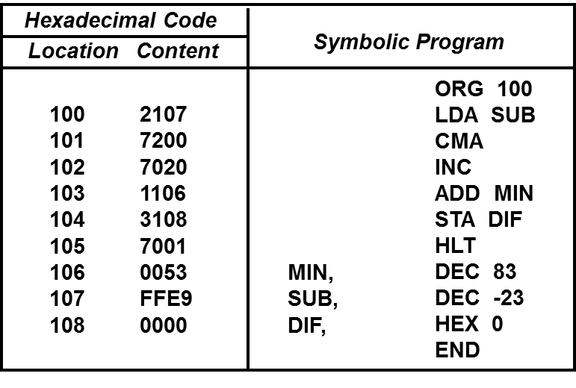
TRANSLATION TO BINARY
Programming the Basic Computer
  Assembly Language

Slide 9
ASSEMBLER - FIRST PASS -
Programming the Basic Computer
Assembler
Assembler
Input → Source Program - Symbolic Assembly Language Program
Output→ Object Program - Binary Machine Language Program
Two pass assembler
1st pass: generates a table that correlates all user defined
(address) symbols with their binary equivalent value
2nd pass: binary translation

Slide 10
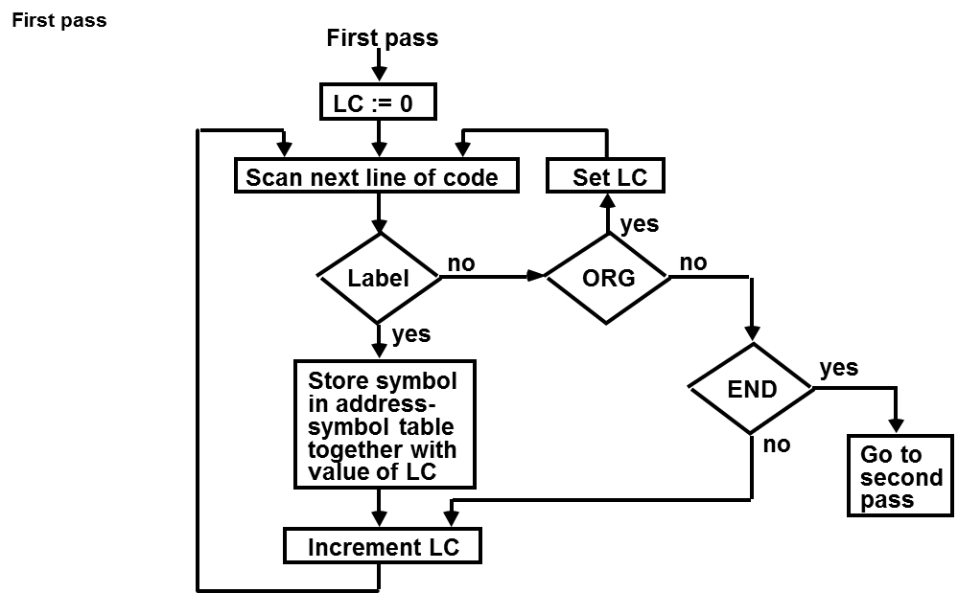
First Pass

Slide 11
ASSEMBLER - SECOND PASS -
Programming the Basic Computer
Assembler
Second Pass
Machine instructions are translated by means of
table-lookup procedures:
      Table1:Pseudo-Instruction.
      Table2: MRI
      Table3: Non-MRI
      Table4: Address Symbol

Slide 12
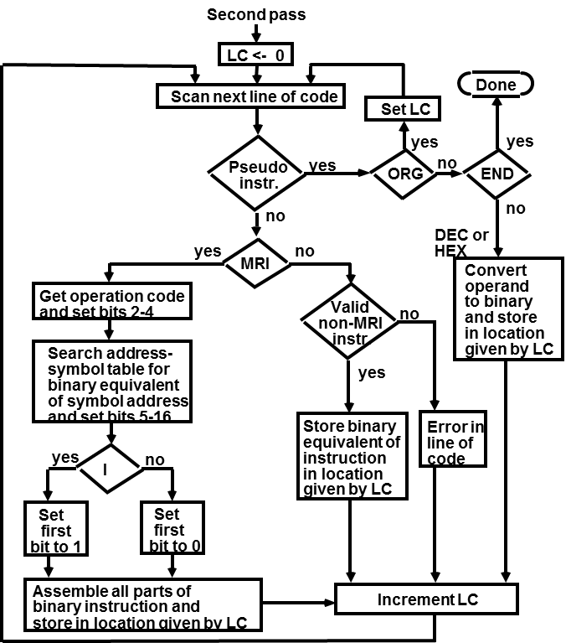
Second Pass

Slide 13
PROGRAM LOOPS
Programming the Basic Computer
Program Loops
Loop: A sequence of instructions that are executed many times,
each with a different set of data
Fortran program to add 100 numbers:
DIMENSION A(100)
INTEGER SUM, A
SUM = 0
DO 3 J = 1, 100
SUM = SUM + A(J)
3
Assembly-language program to add 100 numbers:
ORG 100
LDA ADS
STA PTR
LDA NBR
STA CTR
CLA
ADD PTR I
ISZ PTR
ISZ CTR
BUN LOP
STA SUM
HLT
HEX 150
HEX 0
DEC -100
HEX 0
HEX 0
ORG 150
DEC 75
DEC 23
END
/ Origin of program is HEX 100
/ Load first address of operand
/ Store in pointer
/ Load -100
/ Store in counter
/ Clear AC
/ Add an operand to AC
/ Increment pointer
/ Increment counter
/ Repeat loop again
/ Store sum
/ Halt
/ First address of operands
/ Reserved for a pointer
/ Initial value for a counter
/ Reserved for a counter
/ Sum is stored here
/ Origin of operands is HEX 150
/ First operand
/ Last operand
/ End of symbolic program

Slide 14
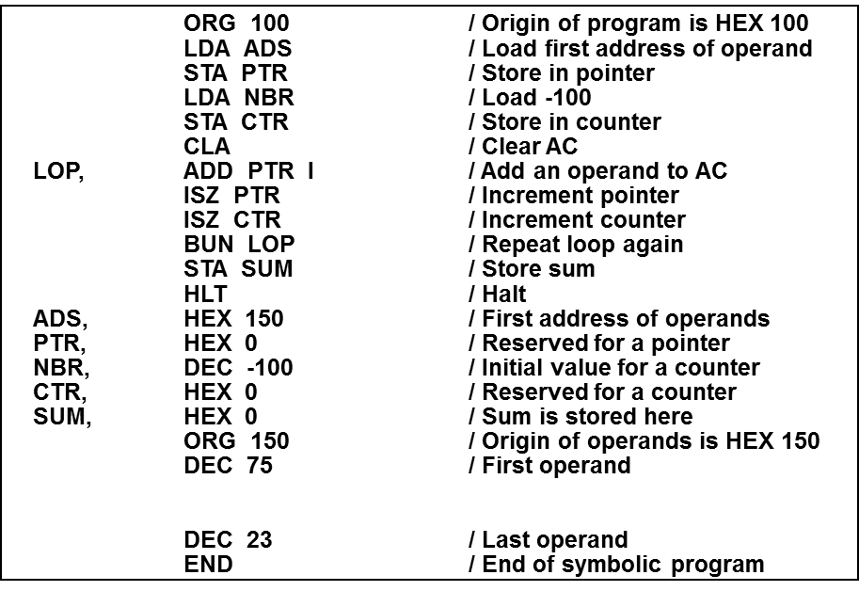
Loops
Assembly-language program to add 100 numbers:

Slide 15
PROGRAMMING ARITHMETIC AND LOGIC OPERATIONS
Programming the Basic Computer
Programming Arithmetic and Logic Operations
Implementation of Arithmetic and Logic Operations
- Software Implementation
- Implementation of an operation with a program
using machine instruction set
- Usually when the operation is not included
in the instruction set
- Hardware Implementation
- Implementation of an operation in a computer
with one machine instruction
Software Implementation example:
* Multiplication
- For simplicity, unsigned positive numbers
- 8-bit numbers -> 16-bit product

Slide 16
FLOWCHART OF A PROGRAM - Multiplication -
Programming the Basic Computer
Programming Arithmetic and Logic Operations
CTR ← - 8
P ← 0
X holds the multiplicand
Y holds the multiplier
P holds the product
E ← 0
AC ← Y
Example with four significant digits
X =
Y =
P
cir EAC
0000 1111
0000 1011 0000 0000
0000 1111 0000 1111
0001 1110 0010 1101
0000 0000 0010 1101
0111 1000 1010 0101
1010 0101
Y ← AC
=0
E
=1
P ← P + X
E ← 0
AC ← X
cil EAC
cil
X ← AC
CTR ← CTR + 1
≠ 0
CTR
=0
Stop

Slide 17
ASSEMBLY LANGUAGE PROGRAM - Multiplication -
Programming the Basic Computer
Programming Arithmetic and Logic Operations
LOP,
ONE,
ZRO,
CTR,
X,
Y,
P,
ORG 100
CLE
LDA Y
CIR
STA Y
SZE
BUN ONE
BUN ZRO
LDA X
ADD P
STA P
CLE
LDA X
CIL
STA X
ISZ CTR
BUN LOP
HLT
DEC -8
HEX 000F
HEX 000B
HEX 0
END
/ Clear E
/ Load multiplier
/ Transfer multiplier bit to E
/ Store shifted multiplier
/ Check if bit is zero
/ Bit is one; goto ONE
/ Bit is zero; goto ZRO
/ Load multiplicand
/ Add to partial product
/ Store partial product
/ Clear E
/ Load multiplicand
/ Shift left
/ Store shifted multiplicand
/ Increment counter
/ Counter not zero; repeat loop
/ Counter is zero; halt
/ This location serves as a counter
/ Multiplicand stored here
/ Multiplier stored here
/ Product formed here

Slide 18
ASSEMBLY LANGUAGE PROGRAM
- Double Precision Addition -
Programming the Basic Computer
Programming Arithmetic and Logic Operations
LDA AL
ADD BL
STA CL
CLA
CIL
ADD AH
ADD BH
STA CH
HLT
/ Load A low
/ Add B low, carry in E
/ Store in C low
/ Clear AC
/ Circulate to bring carry into AC(16)
/ Add A high and carry
/ Add B high
/ Store in C high

Slide 19
ASSEMBLY LANGUAGE PROGRAM
- Logic and Shift Operations -
Programming the Basic Computer
Programming Arithmetic and Logic Operations
Logic operations
- BC instructions : AND, CMA, CLA
- Program for OR operation
LDA A
CMA
STA TMP
LDA B
CMA
AND TMP
CMA
/ Load 1st operand
/ Complement to get A’
/ Store in a temporary location
/ Load 2nd operand B
/ Complement to get B’
/ AND with A’ to get A’ AND B’
/ Complement again to get A OR B
Shift operations - BC has Circular Shift only
- Logical shift-right operation - Logical shift-left operation
CLE CLE
CIR CIL
- Arithmetic right-shift operation
CLE
SPA
CME
CIR
/ Clear E to 0
/ Skip if AC is positive
/ AC is negative
/ Circulate E and AC

Slide 20
SUBROUTINES
Programming the Basic Computer
Subroutines
Subroutine
- A set of common instructions that can be used in a program many times.
- Subroutine linkage : a procedure for branching
to a subroutine and returning to the main program
Example
Loc.
100
101
102
103
104
105
106
107
108
109
10A
10B
10C
10D
10E
10F
110
X,
Y,
SH4,
MSK,
ORG 100
LDA X
BSA SH4
STA X
LDA Y
BSA SH4
STA Y
HLT
HEX 1234
HEX 4321
HEX 0
CIL
CIL
CIL
CIL
AND MSK
BUN SH4 I
HEX FFF0
END
/ Main program
/ Load X
/ Branch to subroutine
/ Store shifted number
/ Load Y
/ Branch to subroutine again
/ Store shifted number
/ Subroutine to shift left 4 times
/ Store return address here
/ Circulate left once
/ Circulate left fourth time
/ Set AC(13-16) to zero
/ Return to main program
/ Mask operand

Slide 21
SUBROUTINE PARAMETERS AND DATA LINKAGE
Programming the Basic Computer
Subroutines
Linkage of Parameters and Data between the Main Program and a Subroutine
- via Registers
- via Memory locations
- ….
Example: Subroutine performing LOGICAL OR operation; Need two parameters
Loc.
200
201
202
203
204
205
206
207
208
209
20A
20B
20C
20D
20E
20F
210
X,
Y,
OR,
TMP,
ORG 200
LDA X
BSA OR
HEX 3AF6
STA Y
HLT
HEX 7B95
HEX 0
HEX 0
CMA
STA TMP
LDA OR I
CMA
AND TMP
CMA
ISZ OR
BUN OR I
HEX 0
END
/ Load 1st operand into AC
/ Branch to subroutine OR
/ 2nd operand stored here
/ Subroutine returns here
/ 1st operand stored here
/ Result stored here
/ Subroutine OR
/ Complement 1st operand
/ Store in temporary location
/ Load 2nd operand
/ Complement 2nd operand
/ AND complemented 1st operand
/ Complement again to get OR
/ Increment return address
/ Return to main program
/ Temporary storage

Slide 22
SUBROUTINE - Moving a Block of Data -
Programming the Basic Computer
Subroutines
MVE,
LOP,
PT1,
PT2,
CTR,
BSA MVE
HEX 100
HEX 200
DEC -16
HLT
HEX 0
LDA MVE I
STA PT1
ISZ MVE
LDA MVE I
STA PT2
ISZ MVE
LDA MVE I
STA CTR
ISZ MVE
LDA PT1 I
STA PT2 I
ISZ PT1
ISZ PT2
ISZ CTR
BUN LOP
BUN MVE I
--
--
--
/ Main program
/ Branch to subroutine
/ 1st address of source data
/ 1st address of destination data
/ Number of items to move
/ Subroutine MVE
/ Bring address of source
/ Store in 1st pointer
/ Increment return address
/ Bring address of destination
/ Store in 2nd pointer
/ Increment return address
/ Bring number of items
/ Store in counter
/ Increment return address
/ Load source item
/ Store in destination
/ Increment source pointer
/ Increment destination pointer
/ Increment counter
/ Repeat 16 times
/ Return to main program
Fortran subroutine
20
SUBROUTINE MVE (SOURCE, DEST, N)
DIMENSION SOURCE(N), DEST(N)
DO 20 I = 1, N
DEST(I) = SOURCE(I)
RETURN
END

Slide 23
INPUT OUTPUT PROGRAM
Programming the Basic Computer
Input Output Program
Program to Input one Character(Byte)
CIF,
CHR,
SKI
BUN CIF
INP
OUT
STA CHR
HLT
--
/ Check input flag
/ Flag=0, branch to check again
/ Flag=1, input character
/ Display to ensure correctness
/ Store character
/ Store character here
Program to Output a Character
COF,
CHR,
LDA CHR
SKO
BUN COF
OUT
HLT
HEX 0057
/ Load character into AC
/ Check output flag
/ Flag=0, branch to check again
/ Flag=1, output character
/ Character is "W"

Slide 24
CHARACTER MANIPULATION
Programming the Basic Computer
Input Output Program
Subroutine to Input 2 Characters and pack into a word
IN2,
FST,
SCD,
--
SKI
BUN FST
INP
OUT
BSA SH4
BSA SH4
SKI
BUN SCD
INP
OUT
BUN IN2 I
/ Subroutine entry
/ Input 1st character
/ Logical Shift left 4 bits
/ 4 more bits
/ Input 2nd character
/ Return

Slide 25
PROGRAM INTERRUPT
Programming the Basic Computer
Input Output Program
Tasks of Interrupt Service Routine
- Save the Status of CPU
Contents of processor registers and Flags
- Identify the source of Interrupt
Check which flag is set
- Service the device whose flag is set
(Input Output Subroutine)
- Restore contents of processor registers and flags
- Turn the interrupt facility on
- Return to the running program
Load PC of the interrupted program

Slide 26
INTERRUPT SERVICE ROUTINE
Programming the Basic Computer
Input Output Program
Loc.
0
1
100
101
102
103
104
200
ZRO,
SRV,
NXT,
EXT,
SAC,
SE,
PT1,
PT2,
-
BUN SRV
CLA
ION
LDA X
ADD Y
STA Z
STA SAC
CIR
STA SE
SKI
BUN NXT
INP
OUT
STA PT1 I
ISZ PT1
SKO
BUN EXT
LDA PT2 I
OUT
ISZ PT2
LDA SE
CIL
LDA SAC
ION
BUN ZRO I
-
-
-
-
/ Return address stored here
/ Branch to service routine
/ Portion of running program
/ Turn on interrupt facility
/ Interrupt occurs here
/ Program returns here after interrupt
/ Interrupt service routine
/ Store content of AC
/ Move E into AC(1)
/ Store content of E
/ Check input flag
/ Flag is off, check next flag
/ Flag is on, input character
/ Print character
/ Store it in input buffer
/ Increment input pointer
/ Check output flag
/ Flag is off, exit
/ Load character from output buffer
/ Output character
/ Increment output pointer
/ Restore value of AC(1)
/ Shift it to E
/ Restore content of AC
/ Turn interrupt on
/ Return to running program
/ AC is stored here
/ E is stored here
/ Pointer of input buffer
/ Pointer of output buffer

